Slide 1

Big Data Analytics Project
Phase 1
AWS HADOOP

Slide 2




DATA ANALYSIS TASKS
Case 1
Determine the three airports with the highest delay time (in hours) for assigned year
Case 2
Determine the three carriers with the highest delay time (in hours) for assigned year
Case 3
Determine overall which type of delay (arrivals or departures) is the largest for airports
Final
Collaborate on the presentation deck and a conclusions slide of the group

Slide 3






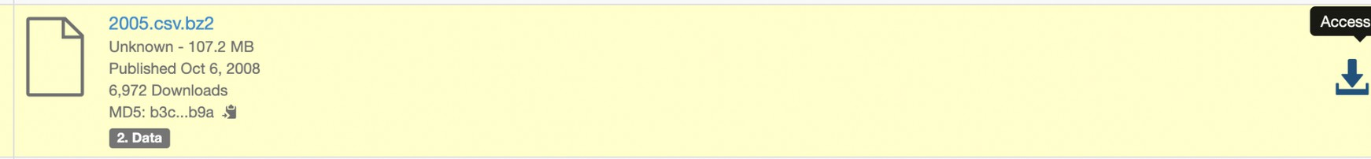





DATA SOURCE
Data Expo 2009: Airline on Time Data
The data represents flight arrival and
departure details for all commercial flights within the USA for year 2005
Download Link
Data Expo 2009: Harward - Airline on Time Data

Slide 4


Steps for working with Data in Hadoop
hdfs dfs -mkdir -p /user/hive/warehouse - Creating directory
hdfs dfs -chmod g+w /user/hive/warehouse - Command to change the permissions of a directory in HDFS
wget https://dataverse.harvard.edu/api/access/datafile/:persistentId?
persistentId=doi:10.7910/DVN/HG7NV7/JTFT25 - Command to upload data with URL
wget https://dataverse.harvard.edu/api/access/datafile/:persistentId? persistentId=doi:10.7910/DVN/HG7NV7/XTPZZY - Data Airports
wget https://dataverse.harvard.edu/api/access/datafile/:persistentId?
persistentId=doi:10.7910/DVN/HG7NV7/3NOǪ6Ǫ - Data Carriers
mv \:persistentId?persistentId=doi:10.7910%2FDVN%2FHG7NV7%2FJTFT25 datayear.csv.bz2
- Creating alias for directory
bzip2 -d datayear.csv.bz2 - Command for unzipping file
mv \:persistentId?persistentId=doi:10.7910%2FDVN%2FHG7NV7%2FXTPZZY airports.csv
mv \:persistentId?persistentId=doi:10.7910%2FDVN%2FHG7NV7%2F3NOǪ6Ǫ airlines.csv 10u. sed hive command to navigate to hive shell for performing SǪL query for creating and
ingesting the cvs data into tables and perform analysis.

Slide 5

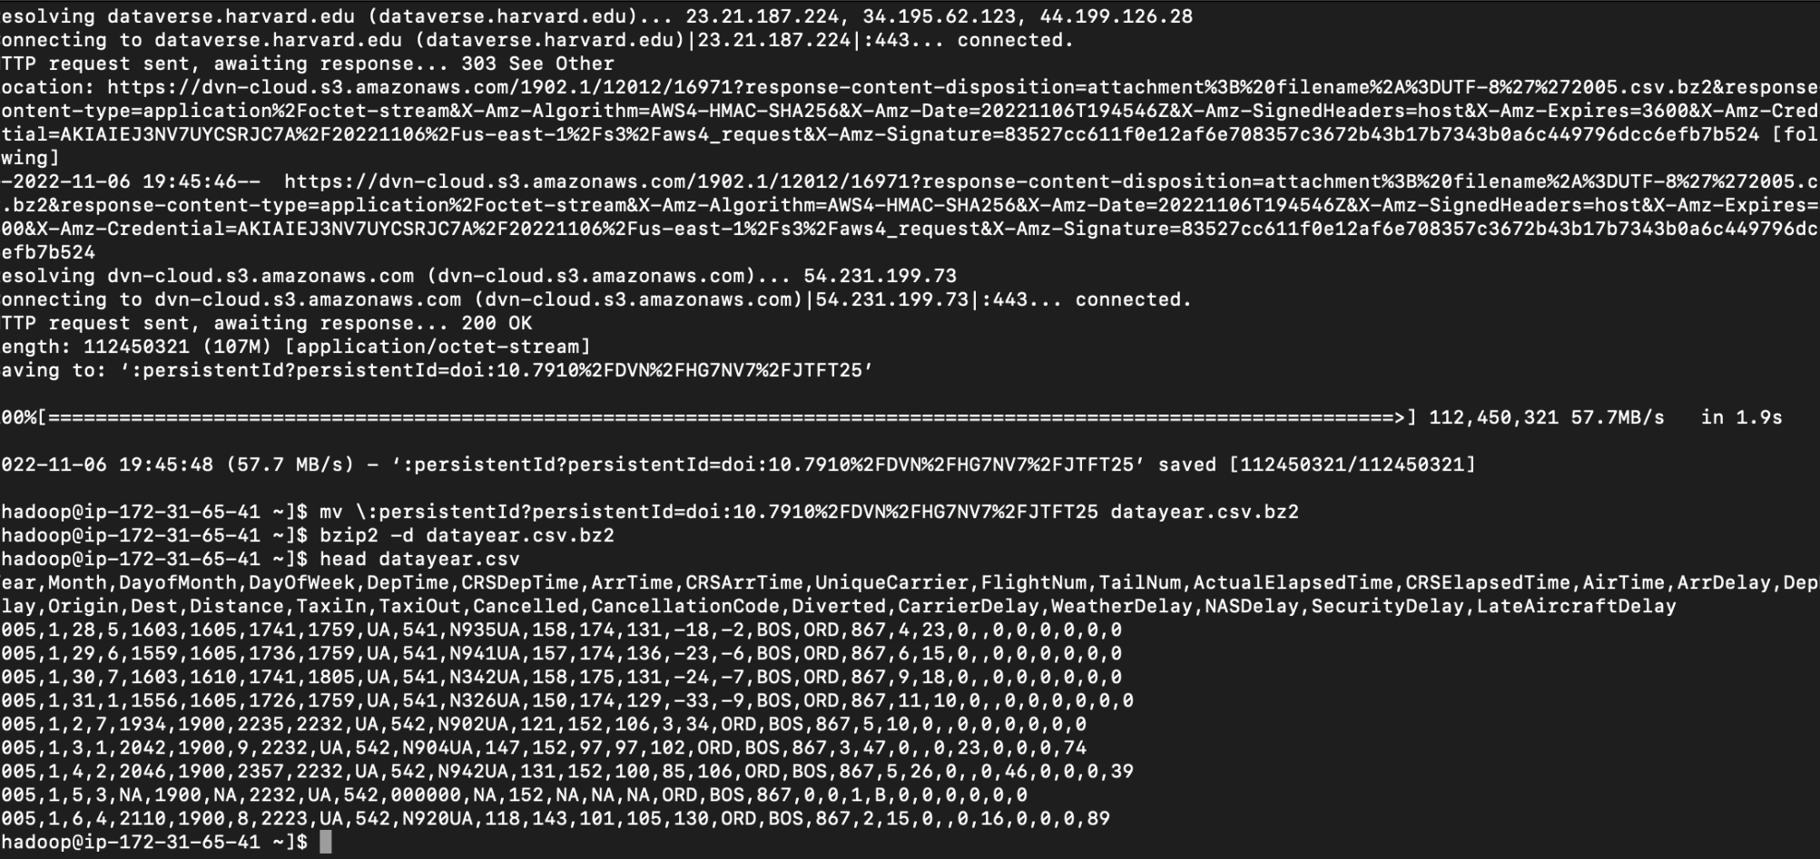
Year 2005 Data uploading in Hadoop
Displayed Data Year

Slide 6

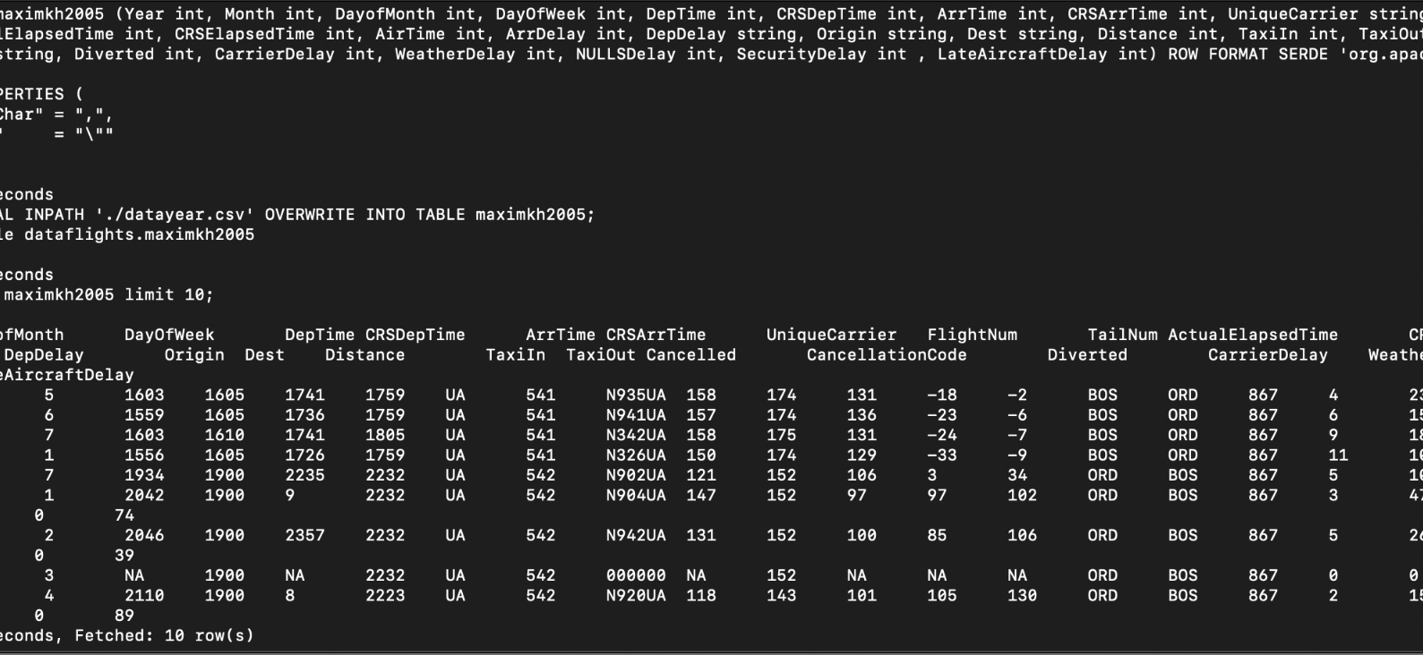
Year 2005 Data Uploading in Table
Displayed Data Year in Table

Slide 7
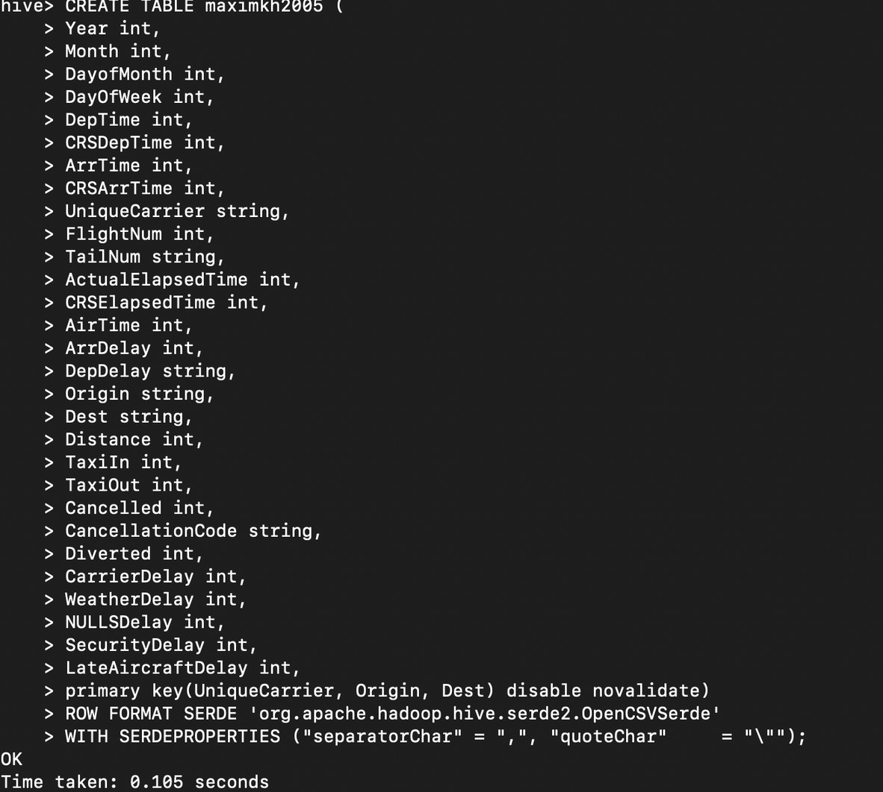
Database and Table structures

Slide 8
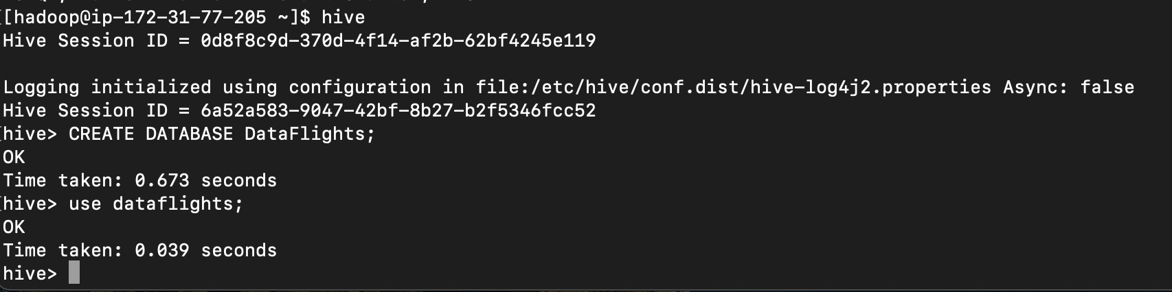
Database and Table structures

Slide 9

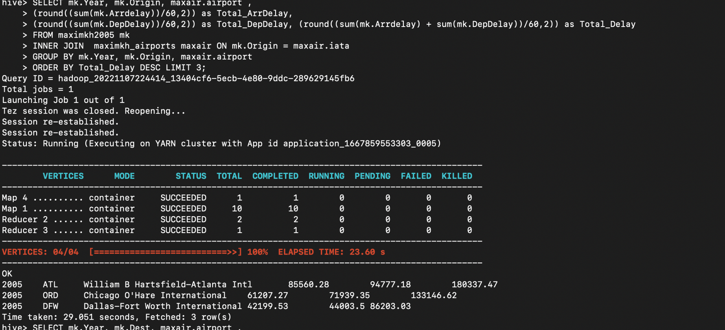








CASE fi
Determine the three uirports (origin) with the highest delay time (in hours) for 2005 (Displayed in hours)

Slide 10


CASE fi: RESULT
The three airports origin with the highest delay time (in hours)
Year 2005 2005 | Airports William B Hartsfield-Atlanta Int Chicago O’Hare International | Arrival Time Delay (In Hours) 85560.28 61207.27 | Departure time Delay (In Hours) 94777.18 71939.35 | Total Delay (In Hours) fi80337.47 fi33fi46.62
2005 | Dallas-Fort Worth International | 42199.53 | 44003.5 | 86203.03

Slide 11
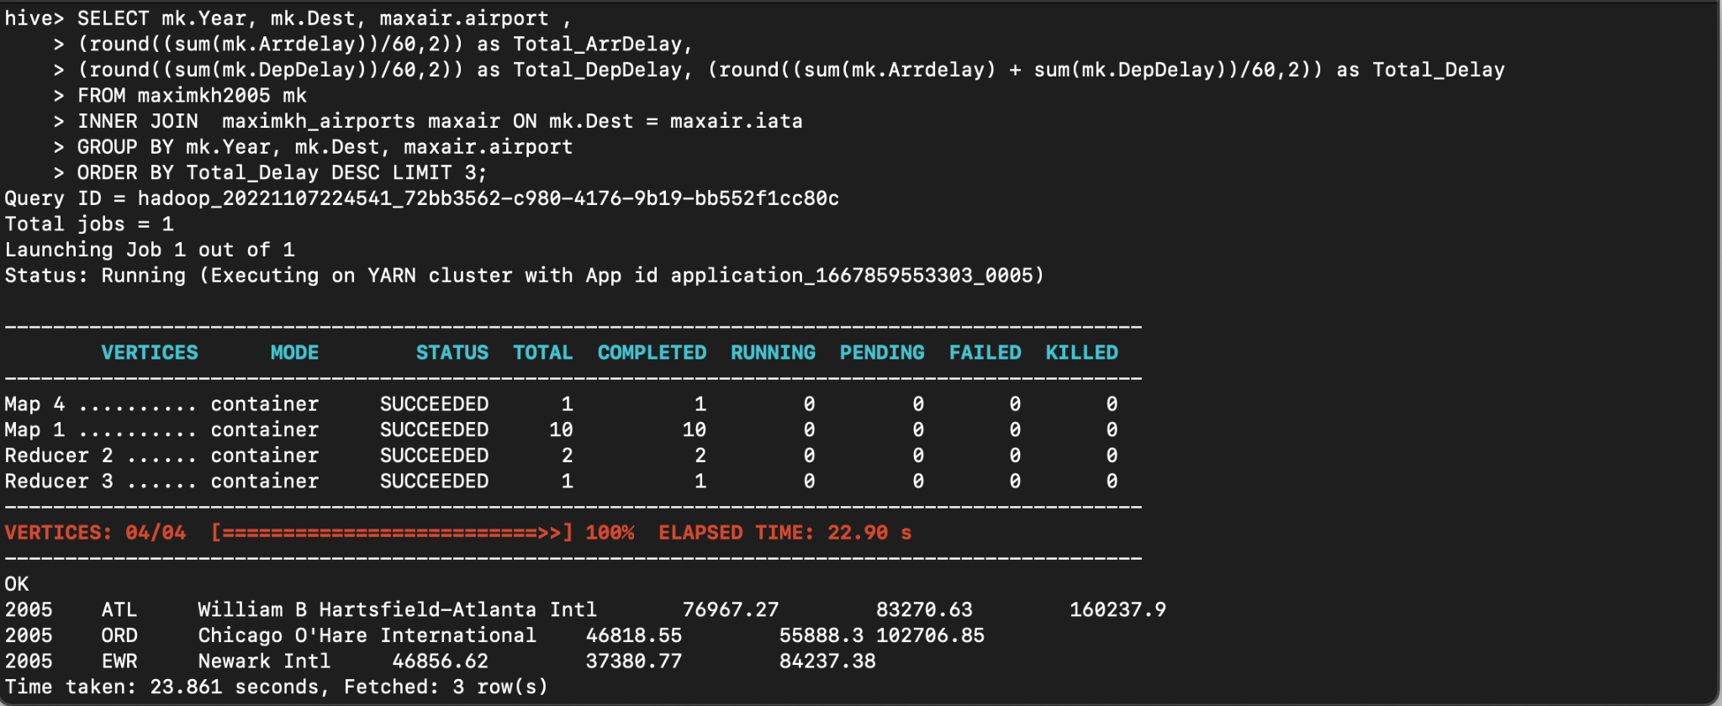

CASE fi
Determine the three uirports (dest) with the highest delay time (in hours) for 2005 (Displayed in hours)

Slide 12
CASE fi: RESULT
The three airports dest with the highest delay time (in hours)
Year 2005 2005 | Airports William B Hartsfield-Atlanta Int Chicago O’Hare International | Arrival Time Delay (In Hours) 76967.27 46818.55 | Departure time Delay (In Hours) 83270.63 55888.3 | Total Delay (In Hours) fi60237.9 fi02706.85
2005 | Newark International | 46856.62 | 37380.77 | 84237.38

Slide 13
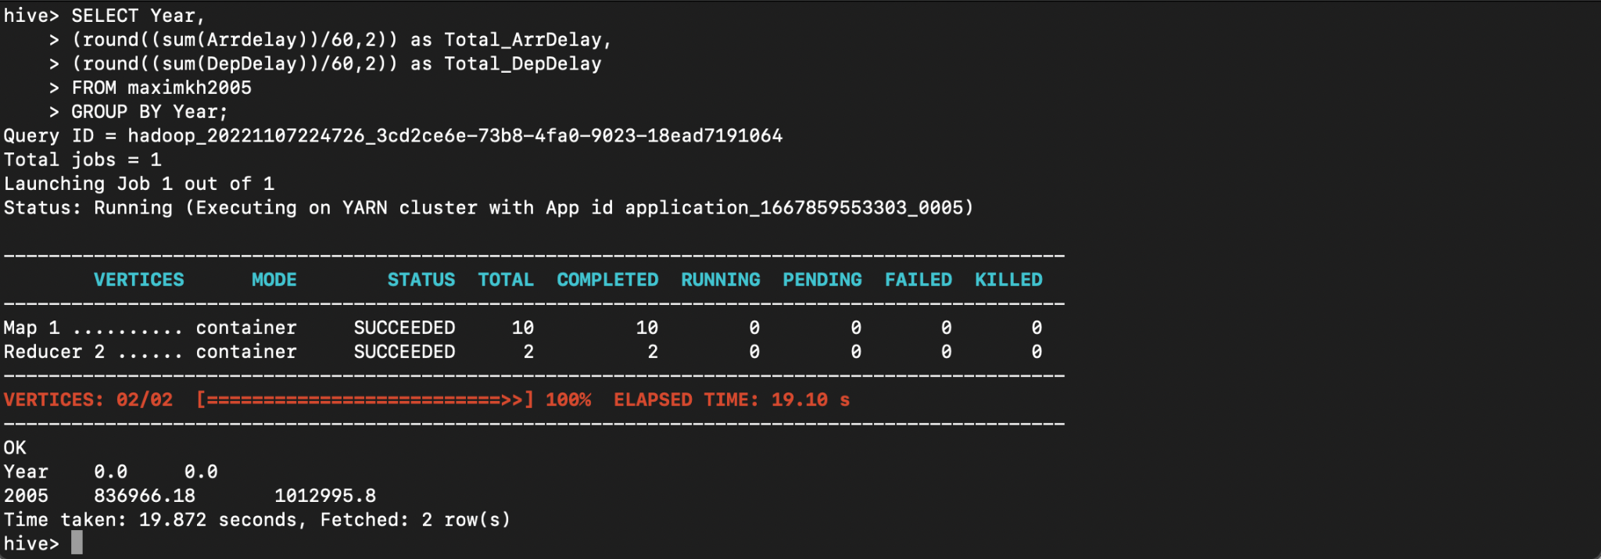
CASE 3
Determine overall which type of delay (arrivals or departures) is the largest (Overall Delays for year 2005)

Slide 14


CASE 3: RESULT
The highest delay time (in hours)
Year | Arrival Time Delay (In Hours) | Departure time Delay (In Hours) | Total Delay (In Hours)
2005 | 836966.18 | 1012995.8 | fi84996fi.98

Slide 15




The three airports origin with the highest delay time (in hours in thousands) for year 2005
200
100
am B Hartsfield-Atlanta Int Chicago O'Hare Int
Dallas-Fort Worth Int
ArrDefay
DepDe\ay
TotafDetay

Slide 16
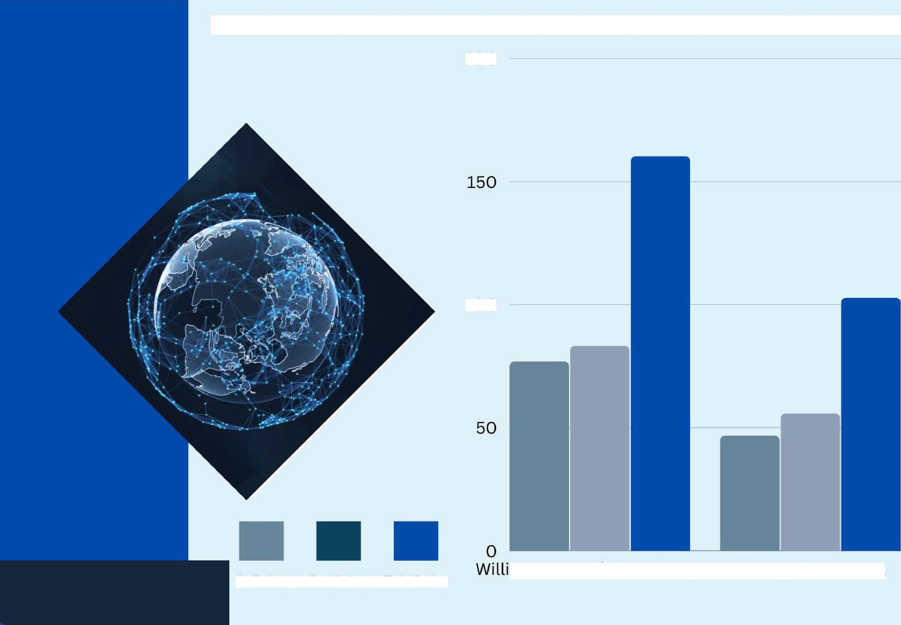


The three airports dest with the highest delay time (in hours in thousands) for year 2005
200
100
am B Hartsfield-Atlanta Int Chicago O'Hare Int
Newark Int
ArrDefay
DepDe\ay
TotafDetay

Slide 17

The three airlines with the highest delay time (in hours in thousands) for year 2005
200
150
100
50
0
Southwest Air Co.
United Air Inc.
Delta Air Inc.
ArrDelay
DepDelay

Slide 18
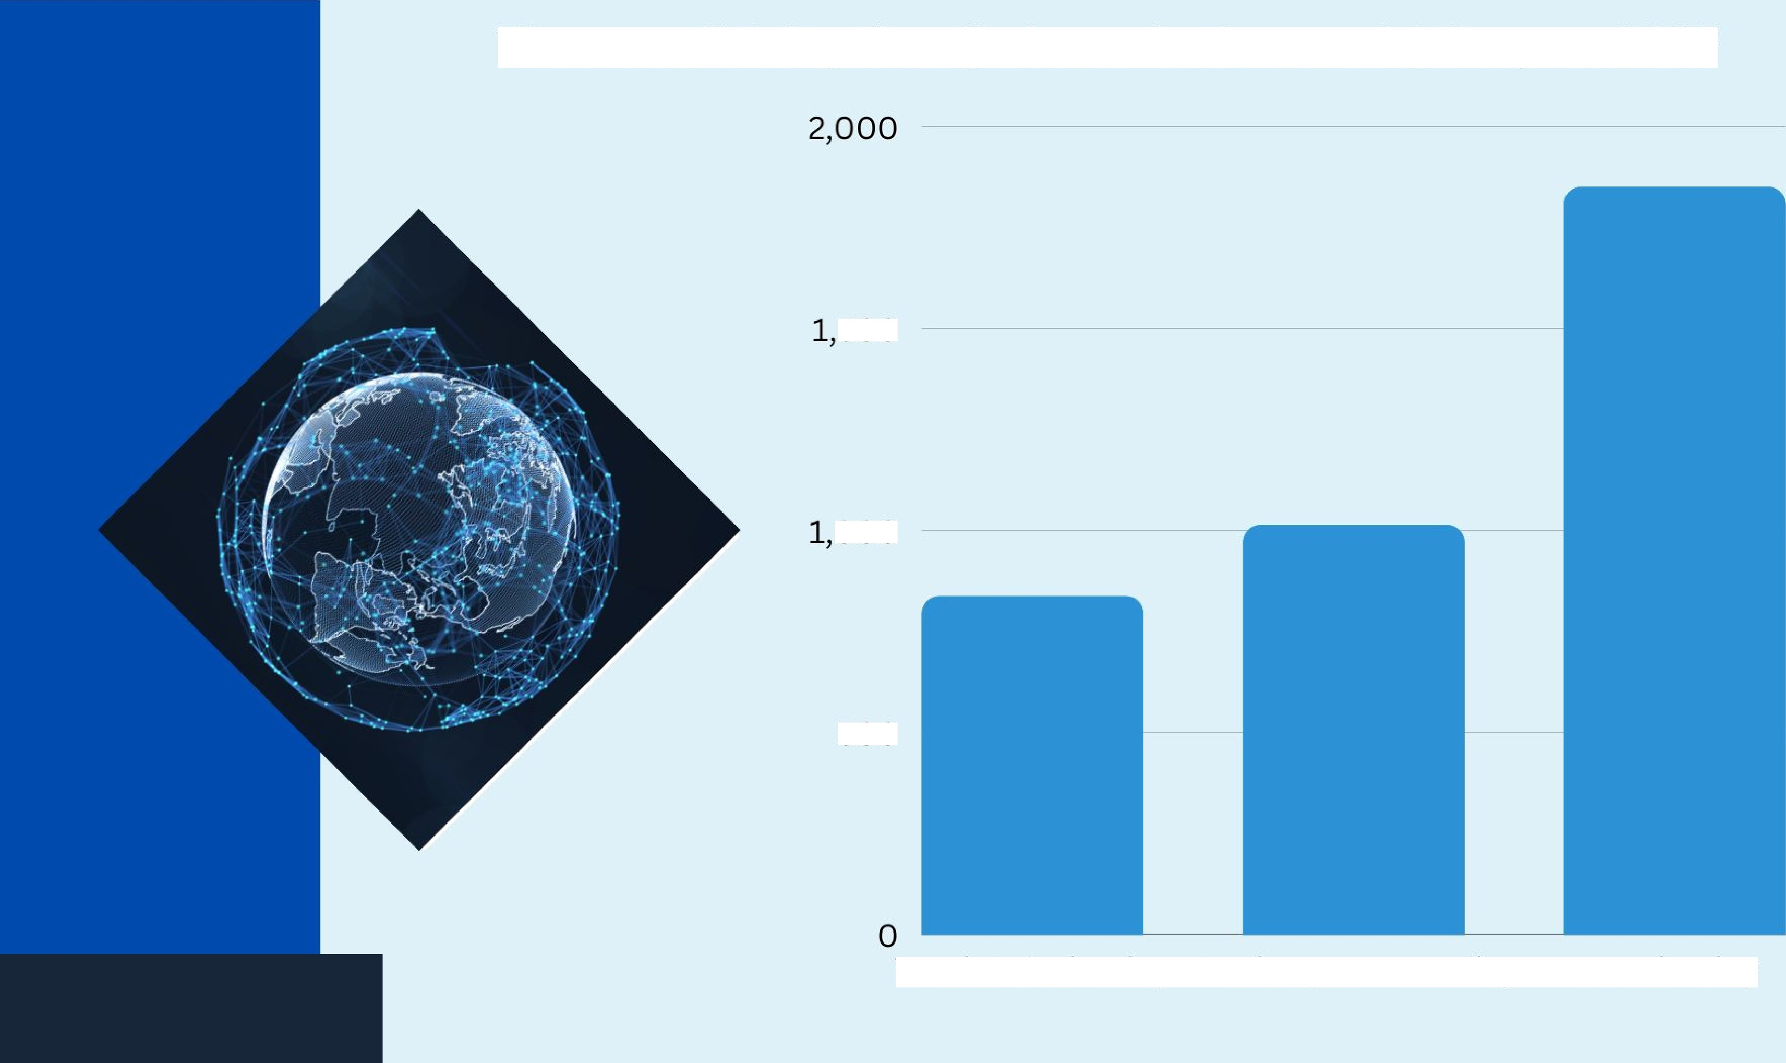
The overall delay time (in hours in thousands) for year 2005
SOO
OOO
SOO
Total Arrival Delay
Total Departure Delay
Total Delay

Slide 19
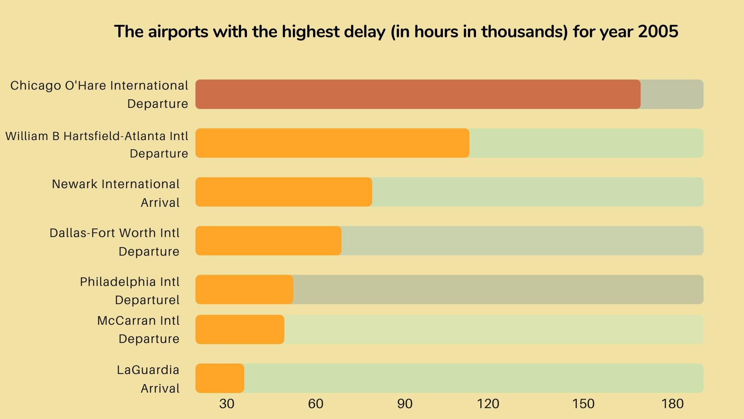


Slide 20

AWS Hadoop

